Slide 1


Presentation
2021863026 류연우
웹프로그래밍응용
1학기 Github

Slide 2
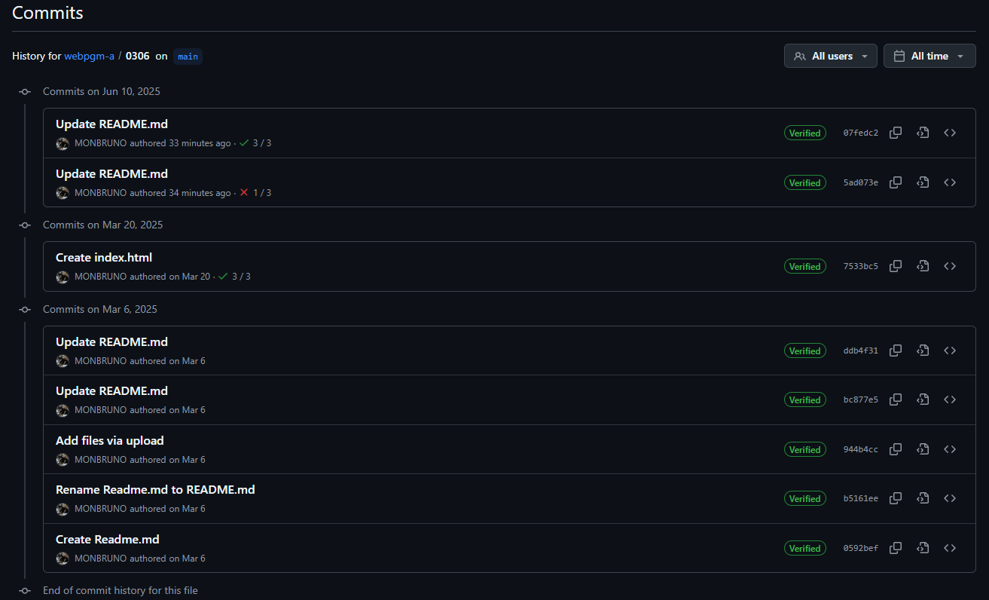
0306
Presentation
1.5

Slide 3
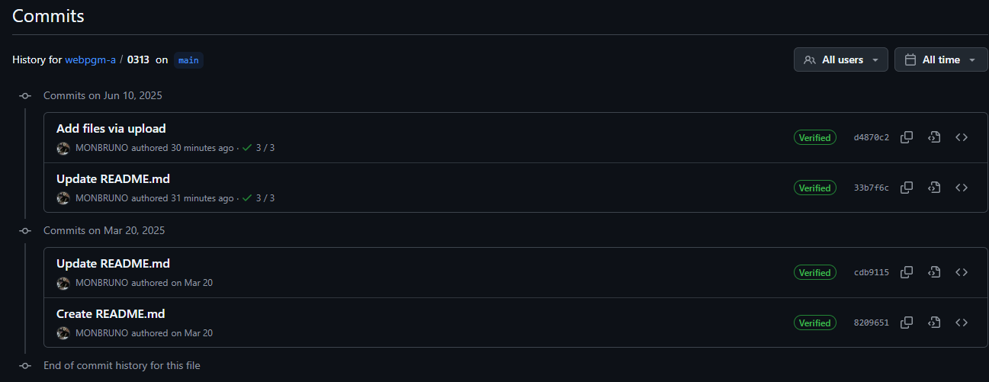
0313
Presentation
1.0

Slide 4
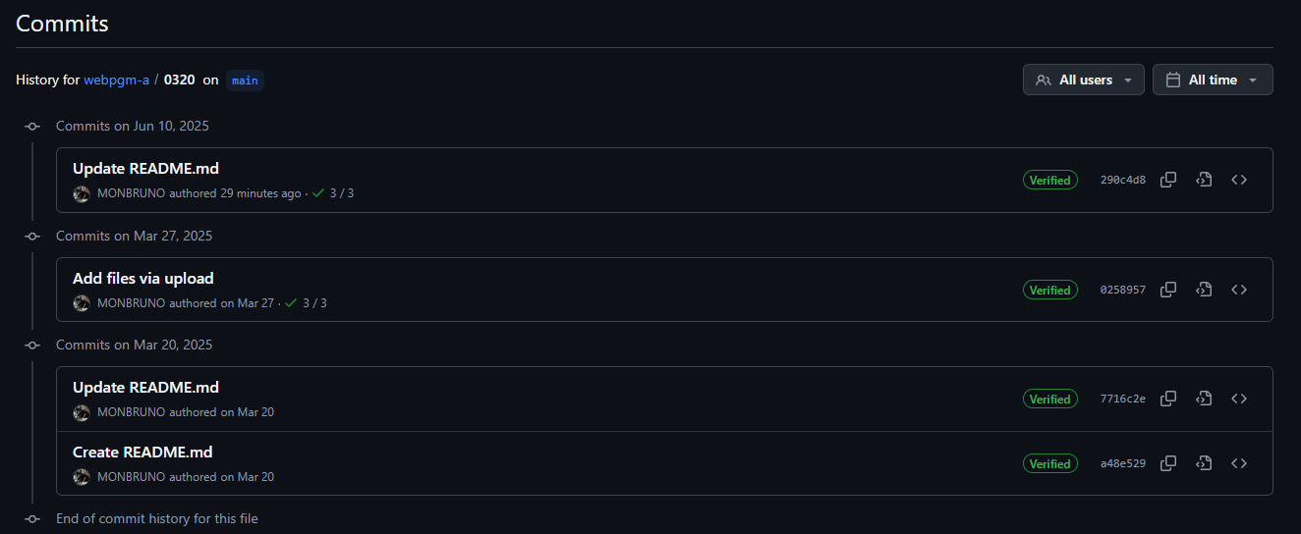
0320
Presentation
1.5

Slide 5
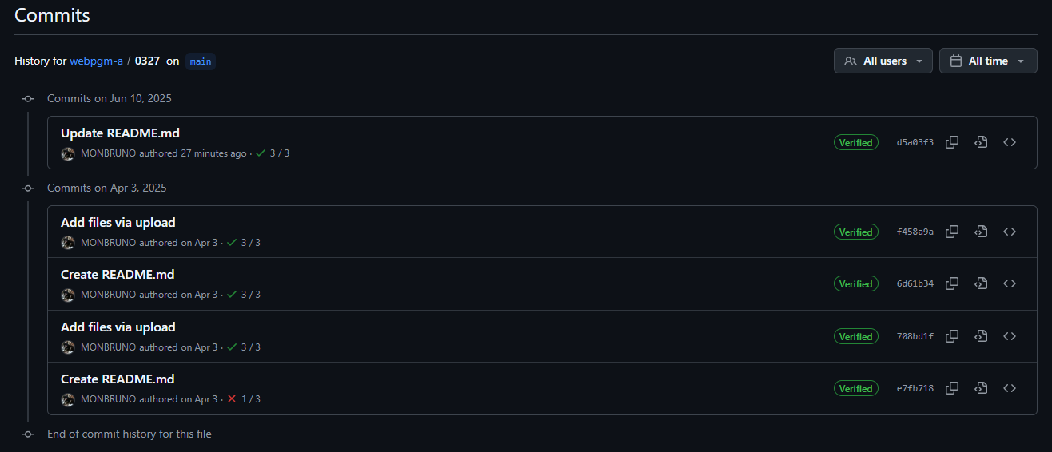
0327
Presentation
1.5

Slide 6
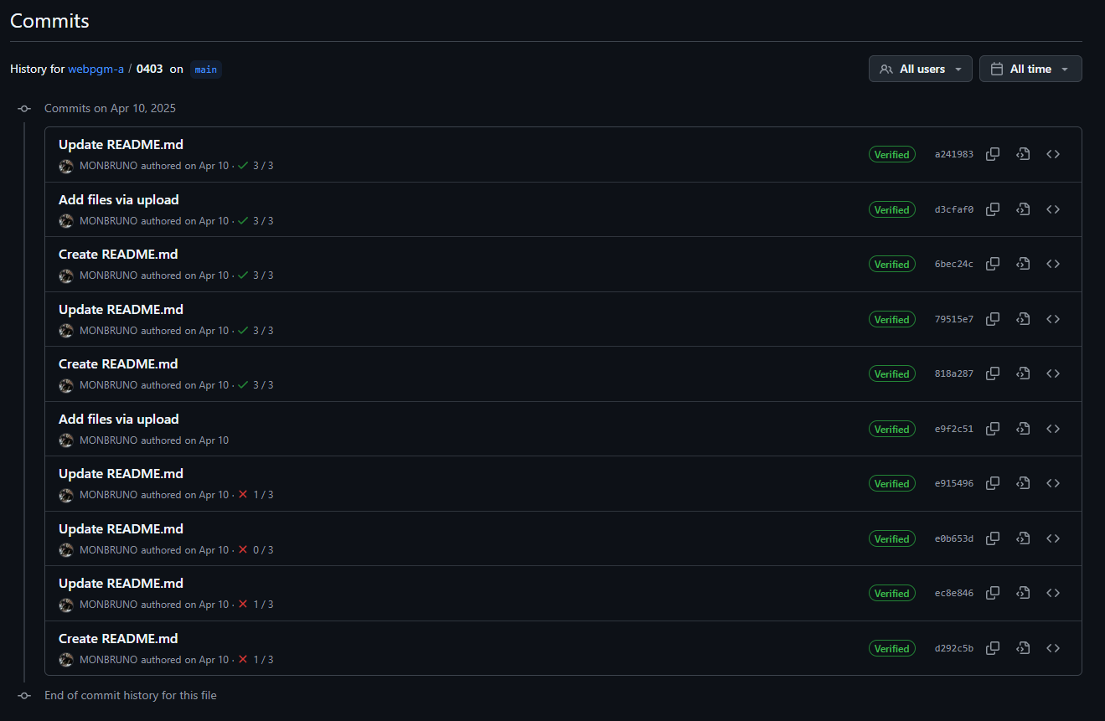
0403
Presentation
1.5

Slide 7
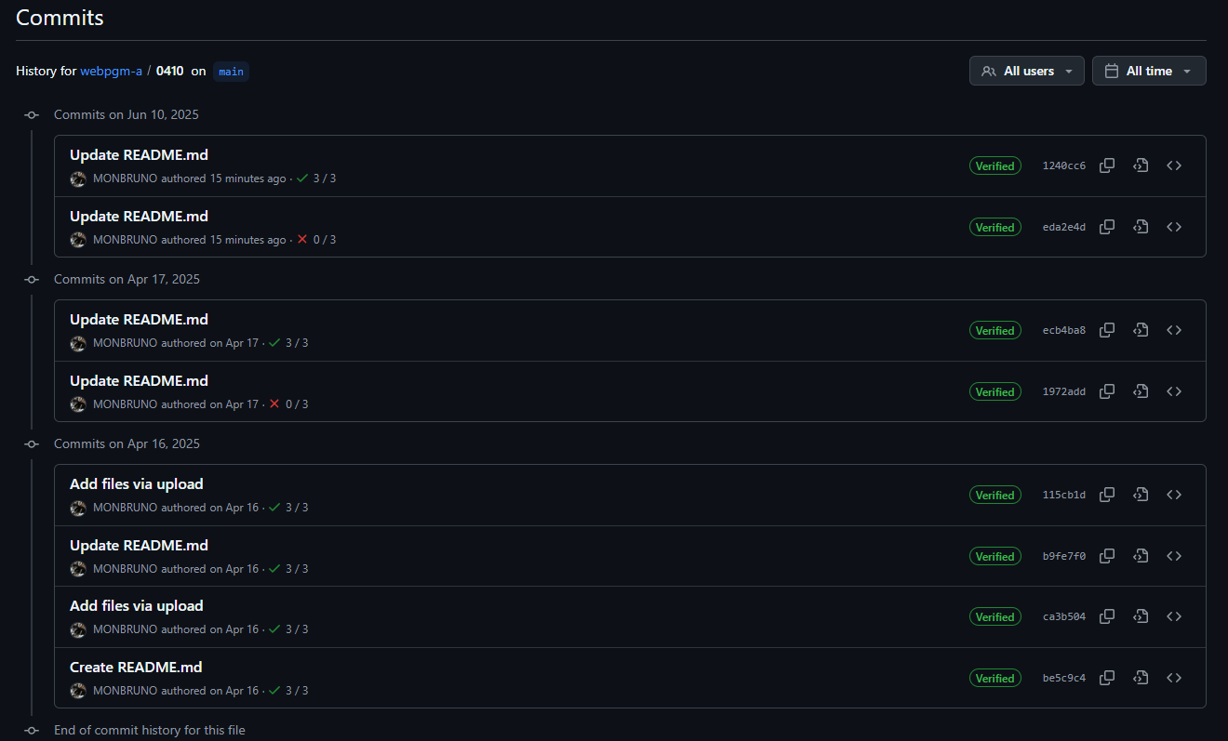
0410
Presentation
1.5

Slide 8
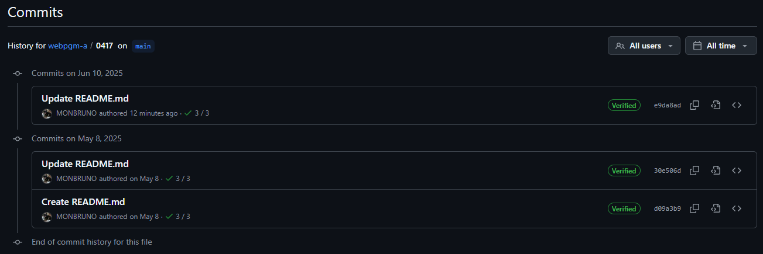
0417
Presentation
1.5

Slide 9
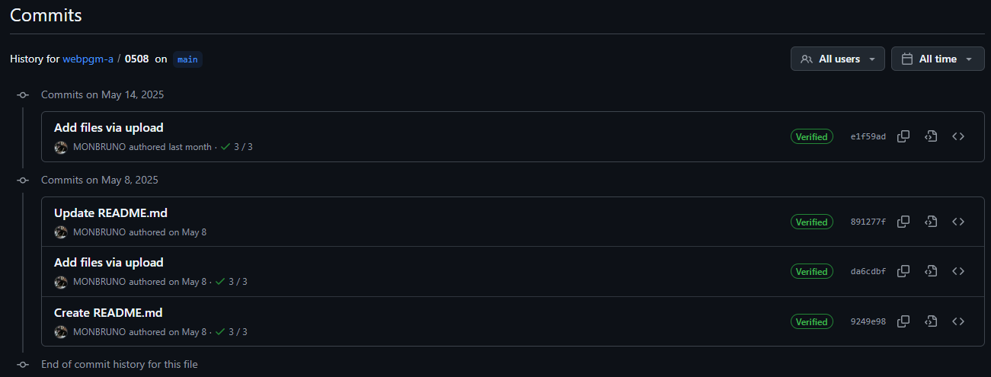
0508
Presentation
1.5

Slide 10
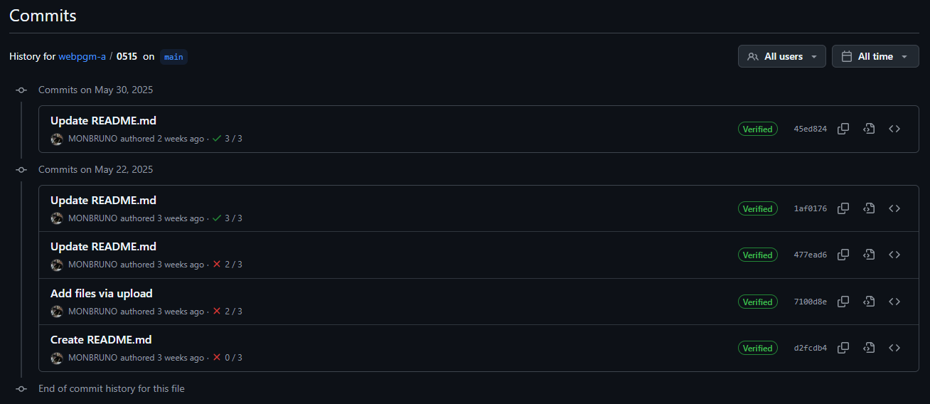
0515
Presentation
1.5

Slide 11
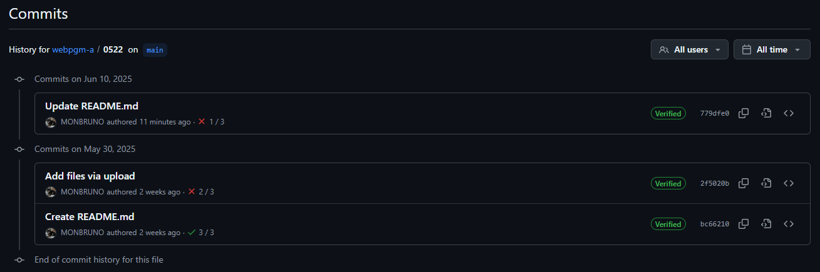
0522
Presentation
1.0

Slide 12
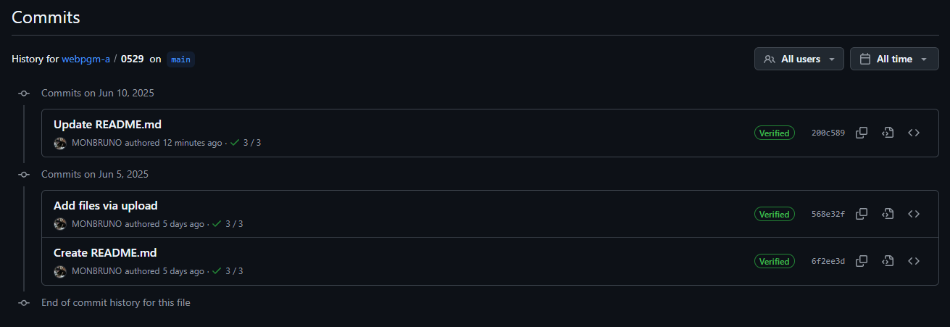
0529
Presentation
1.5

Slide 13
총점
Presentation
1.0 X 2
+ 1.5 X 9
= 15.5
15.5 점
https://github.com/MONBRUNO

Slide 14




Presentation
Thank You!

